Slide 1
Stroke prevention
Arada Rojana-udomsart, M.D., Ph.D.

Slide 2
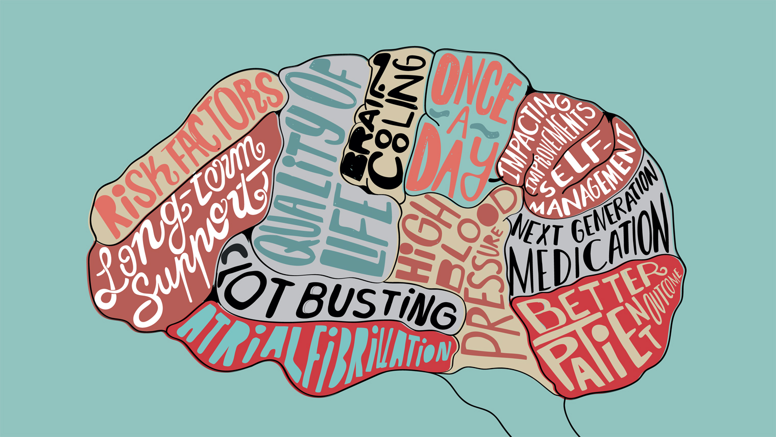
Stroke

Slide 3
What is stroke?
คำจำกัดความของโรคหลอดเลือดสมองโดยองค์การอนามัยโลก:
“rapidly developed clinical signs of focal (global) disturbance of cerebral function lasting more than 24 hours or leading to death, with no apparent cause other than a vascular origin.”
ความผิดปกติของการทำงานของสมอง จากหลอดเลือด แตก ตีบ อุดตัน
จากการศึกษาพบว่า ถ้าผู้ป่วยมีอาการ “ Sudden onset of persistent focal neurological deficit and no history of head trauma ”จะมี probability of stroke 80%

Slide 4
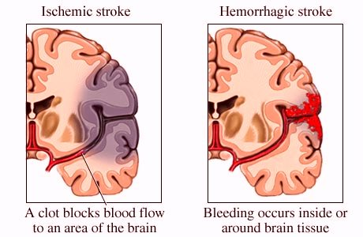
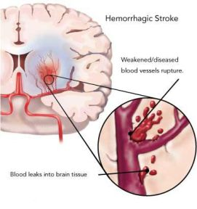
What is stroke?
ประเภทของ Stroke
Hemorrhagic stroke (15-35%)
Ischemic stroke (65-85%)
Embolic
Thrombosis
เมื่อสงสัยว่าเป็น acute stroke ต้องได้รับการตรวจ CT brain ทุกรายเพื่อแยกโรคว่าเป็นischemic หรือ hemorrhagic stroke

Slide 5
What is stroke?

Slide 6
Preventing stroke

Slide 7
Preventing stroke
Primary stroke prevention
Preventing stoke in the individuals with no history of stroke.
Secondary stroke prevention
Preventing stoke in the individuals who have already had a stroke or transient ischemic attack.

Slide 8
Preventing stroke
Independent stroke predictors
age,
systolic blood pressure, hypertension,
diabetes mellitus,
current smoking,
established cardiovascular disease; myocardial infarction, angina or coronary insufficiency, congestive heart failure, and intermittent claudication,
atrial fibrillation, and left ventricular hypertrophy on ECG.
Carotid intima-media thickness

Slide 9
Preventing stroke
Risk factors
Modifiable
Non-modifiable

Slide 10
Preventing stroke-- Primary Prevention
Modifiable risk factors include the following
Athrosclerosis
Hypertension
Cigarette smoking
Diabetes
Dyslipidemia
Diet and activity
Weight and body fat
Atrial fibrillation
Postmenopausal HRT
Cocaine use

Slide 11
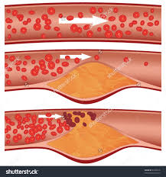
Preventing stroke-- Primary Prevention
Arthrosclerosis
Lose weight
Obesity, raises your odds of having a stroke. If you're overweight, losing as little as 10 pounds can have a real impact on your stroke risk.
Your goal: Keep your body mass index (BMI) at 25 or less.
How to achieve it:
Try to eat no more than 1,500 to 2,000 calories a day
Increase the amount of exercise

Slide 12
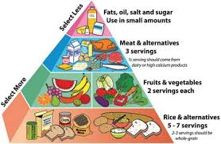
Preventing stroke-- Primary Prevention
Arthrosclerosis
Diet
Unhealthy diet → an increase BP and cholesterol levels.
A low-fat, high-fibre diet is usually recommended.
4-5 cups of fruits and vegetables every day, 1 serving of fish 2-3 times a week, and several daily servings of whole grains and low-fat dairy.
Salt : no more than 0.5-1 tsp/day

Slide 13
Preventing stroke-- Primary Prevention
Athrerosclerosis
Exercise
Exercise contributes to losing weight and lowering BP, but it also be an independent stroke reducer.
Physical activity is associated with a reduction in the risk of stroke
Healthy adults should perform at least moderate- to vigorous-intensity aerobic physical activity at least 40 min/d 3 to 4 d/wk. (Exercise at a moderate intensity at least 5 days a week).
How to achieve it:
Take a walk around your neighborhood .
Start a fitness club with friends.
Exercise reaching the level that you're breathing hard, but you can still talk.
Take the stairs instead of an elevator when you can.
If you don't have 30 consecutive minutes to exercise, break it up into 10- to 15-minute sessions a few times each day.

Slide 14
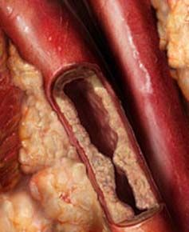
Preventing stroke-- Primary Prevention
Arthrosclerosis
Quit smoking
Smoking thickens your blood, and increases the amount of plaque buildup in the arteries.
Don't give up. Most smokers need several tries to quit.
Use quit-smoking aids, such as nicotine pills or patches, counseling, or medicine.

Slide 15
Preventing stroke-- Primary Prevention
Athrerosclerosis
Cut down on alcohol
Excessive alcohol consumption lead to high BP and trigger atrial fibrillation.
Alcoholic drinks are high in calories, they also cause weight gain.
Drink — in moderation
Drinking can make you less likely to have a stroke — up to a point. "Studies show that if you have about 1 drink per day, your risk may be lower," BUT "Once you start drinking more than 2 drinks per day, your risk goes up very sharply."

Slide 16
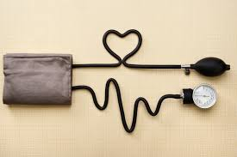
Preventing stroke-- Primary Prevention
Arthrosclerosis
Lower blood pressure
High BP doubling or even quadrupling your stroke risk if it is not controlled. "High BP is the biggest contributor to the risk of stroke in both men and women,"
Maintain a BP of less than 140/90mmHg (120/80 if high risk)
Reduce the salt, Avoid high-cholesterol foods, get more exercise.
Hypertension: Recommendations
1. Regular BP screening and appropriate treatment of patients with HT, including lifestyle modification and pharmacological therapy.
2. Annual screening for high BP and health-promoting lifestyle modification are recommended for patients with prehypertension (SBP of 120 to 139 mm Hg or DBP of 80 to 89 mm Hg).
3. Patients who have HT should be treated with antihypertensive drugs to a target BP of <140/90 mm Hg.
4. Successful reduction of BP is more important in reducing stroke risk than the choice of a specific agent, and treatment should be individualized on the basis of other patient characteristics and medication tolerance.
5. Self-measured BP monitoring is recommended to improve BP control.

Slide 17
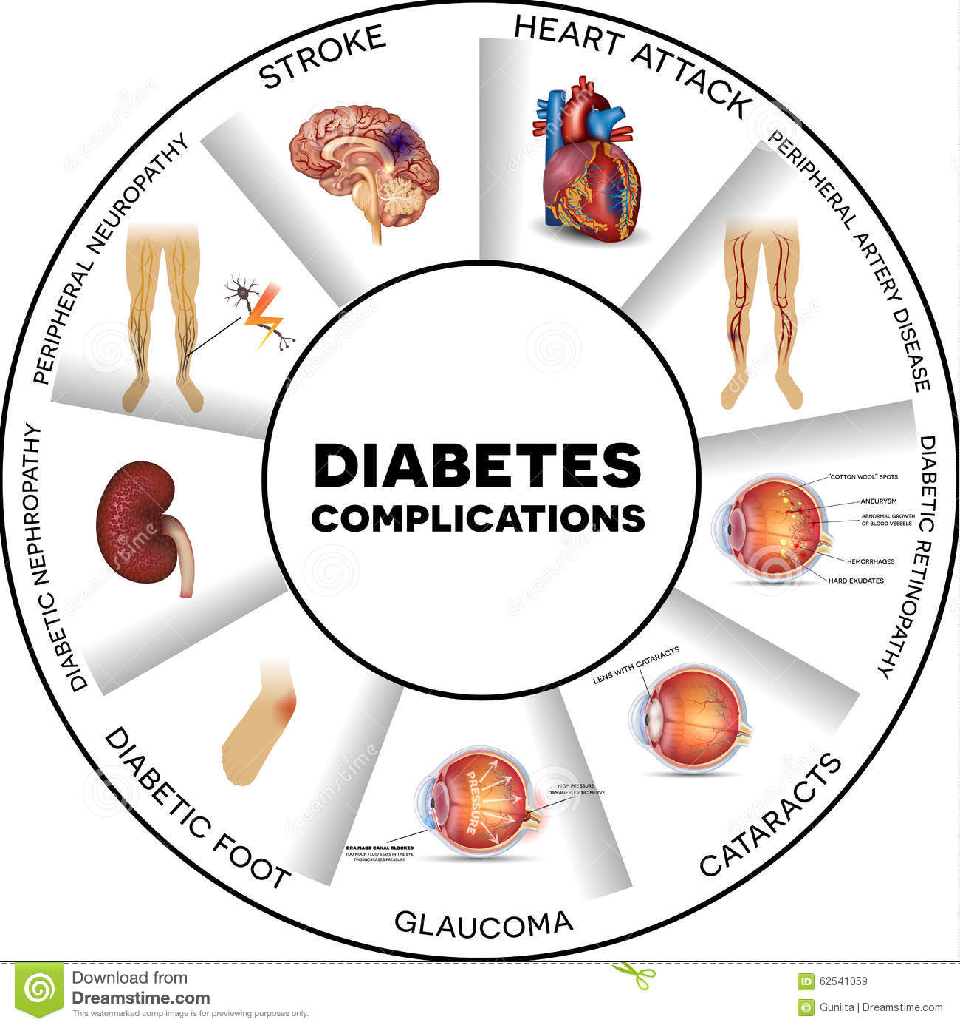
Preventing stroke-- Primary Prevention
Artherosclerosis
Treat diabetes
High blood sugar damages blood vessels over time, making clots more likely to form.
Use diet, exercise, and medicines.
Recommendations
Control of BP in accordance with an AHA/ACC/ CDC Advisory218 to a target of <140/90 mm Hg in patients with type 1 or type 2 diabetes mellitus.
Another guidelines have emphasized the more rigorous control of BP with lower targets of 130/80 mm Hg.
Treatment of adults with diabetes mellitus with a statin, especially those with additional risk factors, is recommended to lower the risk of first stroke
The usefulness of aspirin for primary stroke prevention for patients with diabetes mellitus but low 10-year risk of CVD is unclear

Slide 18
Preventing stroke-- Primary Prevention
Dyslipidemia
Recommendations
In addition to therapeutic lifestyle changes, treatment with statin medication is recommended for the primary prevention of ischemic stroke in patients estimated to have a high 10-year risk for cardiovascular events as recommended in the 2013 “ACC/AHA Guideline.

Slide 19
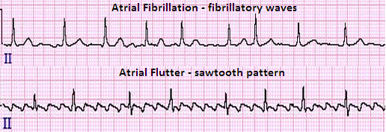
Preventing stroke-- Primary Prevention
Atrial fibrillation (AF)
AF causes clots to form in the heart. Those clots can then travel to the brain, producing a stroke. "Atrial fibrillation carries almost a fivefold risk of stroke, and should be taken seriously,"
If patients have symptoms such as palpitations , look for AF.
Warfarin (Coumadin) may be needed to reduce stroke risk from AF.

Slide 20
Stroke prevention Non modifiable risks
Age
Chance of having a stroke approximately doubles for each decade of life after age 55.
An analysis of data from 8 European countries found that the combined risk of fatal and nonfatal stroke increased by 9%/y in men and 10%/y in women.
Race — African-American vs Caucasians.
Low Birth Weight
Sex (gender) —
เพศชายมีความเสี่ยงต่อ atherosclerosis สูงกว่าเพศหญิง
Each year, women have more strokes than men.
Prior stroke or MI

Slide 21
Stroke prevention Non modifiable risks
Genetic facrtors
family history of vascular disease, genetic diseases
Monozygotic VS dizygotic twins
Common variants on chromosome 9p21 which were initially found to be associated with MI, have also been associated with large-artery ischemic stroke.
A variant in the PRKCH gene has been associated with small-vessel stroke in Asians.
The genetic variants described to date account for only a small proportion of stroke risk. Even combined, their predictive value is likely to be low.
Genetic Factors: Recommendations
1. Obtaining a family history can be useful in identifying people who may have increased stroke risk
2. Noninvasive screening for unruptured intracranialaneurysms in patients with ≥2 first-degree relativeswith SAH or intracranial aneurysms might be reasonable

Slide 22
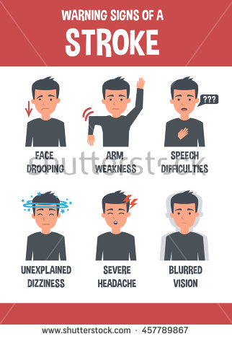
Stroke attack
https://www.youtube.com/watch?v=RwGc7-R1v0Q

Slide 23
Secondary Prevention of Stroke/TIA
Importance
Survivors of a transient ischemic attack (TIA) or stroke have an increased risk of another stroke.
2/7 of stroke patients in the US are people with recurrent stroke.
The number of people with TIA, and therefore at risk for stroke, is estimated to be much greater.
http://stroke.ahajournals.org/content/37/2/577

Slide 24
Secondary Prevention of Stroke/TIA AHA guidelines: Hypertension
There is a continuous association between both SBP and DBP and the risk of ischemic stroke.
Meta-analyses of randomized controlled trials confirm an approximate 30% to 40% stroke risk reduction with BP lowering

Slide 25
Secondary Prevention of Stroke/TIA AHA guidelines: Hypertension
Recommendations
Antihypertensive treatment is recommended for both prevention of recurrent stroke and prevention of other vascular events in persons who have had an ischemic stroke or TIA and are beyond the hyperacute period
Because this benefit extends to persons with and without a history of hypertension, this recommendation should be considered for all ischemic stroke and TIA patients .
An absolute target BP level and reduction are uncertain and should be individualized, but benefit has been associated with an average reduction of ≈10/5 mm Hg, and normal BP levels have been defined as <120/80 mm Hg by JNC-7.
Lifestyle modifications should be included as part of a comprehensive antihypertensive therapy.
The optimal drug regimen remains uncertain; however, the available data support the use of diuretics and the combination of diuretics and an ACEI. The choice of specific drugs and targets should be individualized on the basis of reviewed data and consideration of specific patient characteristics

Slide 26
Secondary Prevention of Stroke/TIA AHA guidelines: Diabetes
Diabetes is a clear risk factor for stroke and data supporting diabetes as a risk factor for recurrent stroke
Recommendations
More rigorous control of BP and lipids should be considered in patients with diabetes. ACEIs and ARBs are more effective in reducing the progression of renal disease and are recommended as first-choice medications for patients with DM.
Glucose control is recommended to near-normoglycemic levels among diabetics with ischemic stroke or TIA to reduce microvascular complications and possibly macrovascular complications. The goal for hemoglobin A_{1c} should be ≤7%

Slide 27
Secondary Prevention of Stroke/TIA AHA guidelines: Lipids
Hypercholesterolemia and hyperlipidemia are not as well established as risk factors for first or recurrent stroke in contrast to what is seen in cardiac disease.
National Cholesterol Education Program (NCEP) (Adult Treatment Panel III) is the most comprehensive guide for management of lipids in persons at risk for or who have cerebrovascular disease.
NCEP emphasizes 2 major modalities for LDL-C lowering: lifestyle change and medications.
LDL-C goals and cutpoints for initiation of therapeutic lifestyle change and drug therapy are based on 3 categories of risk:
When there is a history of CHD and CHD risk equivalents, the target LDL-C goal is <100 mg/dL.
an addendum to the ATP III algorithm .
in very-high-risk persons ; aim for an LDL-C of <70 mg/dL.
Very-high-risk patients are those who have established cardiovascular disease plus
(1) multiple major risk factors (especially diabetes),
(2) severe and poorly controlled risk factors (especially continued cigarette smoking),
(3) multiple risk factors of the metabolic syndrome (especially high triglycerides ≥200 mg/dL with low HDL cholesterol [<40 mg/dL]),
(4) patients with acute coronary syndromes

Slide 28
Secondary Prevention of Stroke/TIA
Secondary prevention can be summarized by the mnemonic A, B, C, D, E, as follows:
A - Antiaggregants (aspirin, clopidogrel, extended-release dipyridamole, ticlopidine) and anticoagulants (apixaban, dabigatran, edoxaban, rivaroxaban, warfarin)
B - Blood pressure–lowering medications
C - Cessation of cigarette smoking, cholesterol-lowering medications, carotid revascularization
D - Diet
E – Exercise
Smoking cessation, blood pressure control, diabetes control, a low-fat diet, weight loss, and regular exercise should be encouraged.

Slide 29
Secondary Prevention of Stroke Another modifiable factor
Transient ischemic attacks (TIAs).
Recognizing and treating TIAs can reduce the risk of a major stroke.
"warning strokes" that produce stroke-like symptoms but no lasting damage.
Strong predictors of stroke (10 times more likely).
TIA should be considered a medical emergency.

Slide 30
Stroke awereness : Why it’s important
1/3 of people do not know the warning signs of a stroke *.
Stroke is the third leading cause of death (20.6 in 100000 in 2010) and the most common cause of long-term disability in Thailand.
เป็นสาเหตุของการสูญเสียปีสุขภาวะ (Disability Adjusted Life Year) ที่สำคัญอันดับที่ 2 ทั้งในชายและหญิง
It requires immediate medical attention. The sooner a stroke is identified and treated, the better the likelihood of a positive outcome.
*American Stroke Association, news release October 19th, 2015. http://www.strokeassociation.org/STROKEORG/General/World-Stroke-Day-2012_UCM_444999_SubHomePage.jsp

Slide 31
